Slide 1
Business Location Explore in Toronto
Bin Yu
2020.04.21
Peer-graded Assignment for Course Applied Data Science Capstone, Week 4/5

Slide 2
Business Location Explore in Toronto
Contents
1. Introduction
2. Data Collection
3. Methodology
4. Result
5. Discussion
6. Conclusion

Slide 3
1. Introduction
1.1 Business Requests
1.2 Analytic Approach

Slide 4
1.1 Business Requests
Generate The location problem
Location to start a new business
We assume:
An investor wants to start a new business to serve Chinese food in downtown Toronto due to its density of population, higher average income, as well as the diversity of culture.

Slide 5
1.2 Analytic Approach
A good location should satisfy the two criteria at the same time:
(1) Sufficient demand
(2) Insufficient support

Slide 6
2. Data Collection
2.1 Scrape location info in Toronto
2.2 Fetch all 'FOOD' venues in Toronto
2.3 Show venues on map

Slide 7
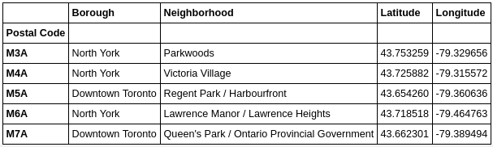
2.1 Scrape location info in Toronto
Step(1) Fetch postal code in Toronto
Step(2) Attaching geo info for each postal code

Slide 8
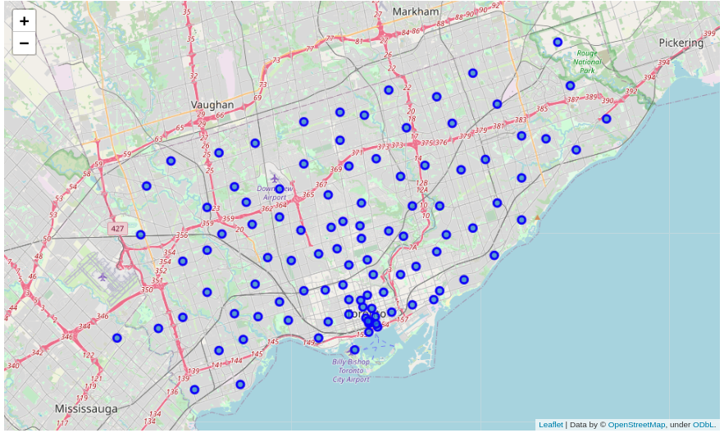
2.1 Scrape location info in Toronto
Step (3) Visualization areas on map

Slide 9
2.2 Fetch all 'FOOD' venues in Toronto
Step(1) First we set API credentials
Step(2) Fetch data via FourSquare API
Step(3) Review venues contains Restaurant in their Name

Slide 10
2.3 Show venues on map
Step (1) Find the center of the map
Step (2) Mark the venues on maps

Slide 11
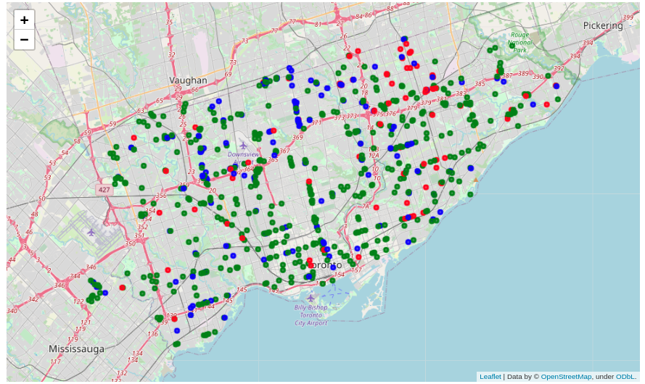
Mark the Restaurants on maps

Slide 12
3. Methodology
3.1 Definition of Sufficiency and InSufficiency
3.2 Isolation Forest Anomaly Dection

Slide 13
3.1 Definition of Sufficiency and InSufficiency
Sufficient Demand :
a bigger average restaurant provider over the area
Insufficient Support:
a smaller average restaurant business over the area

Slide 14
3.2 Isolation Forest Anomaly Dection
Step (1) Define and Fit the model
IF_cols = ['Avg_ChineseR','Avg_AsianR','Avg_OtherR','Avg_AnyR']
model=IsolationForest( n_estimators=50, max_samples='auto', contamination=float(0.1), max_features=4 )
model.fit( df_avg[])

Slide 15

3.2 Isolation Forest Anomaly Dection
Step (2) Attached Scores and Anomaly Column

Slide 16
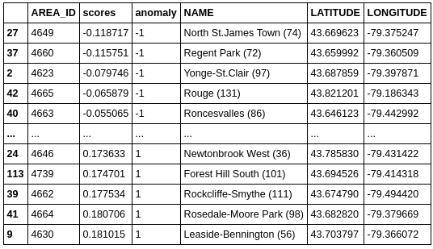
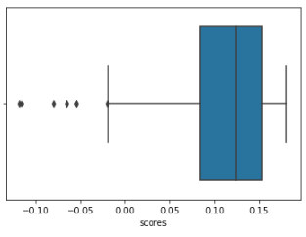
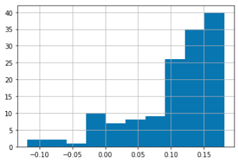
3.2 Isolation Forest Anomaly Dection

Slide 17
4. Result
To open a new Chinese restaurant, we have two locations with potentially highest opportunites, marked as Red on above map:
North St.James Town
Regent Park
Plus the other three locations may also have moderate oppertunites, marked as Orange on above map:
Yonge-St.Clair
Rouge
Roncesvalles

Slide 18
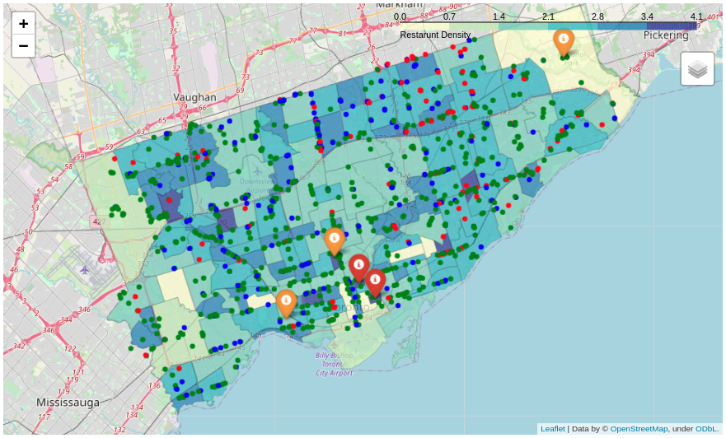
4. Result

Slide 19
5. Discussion
We could add more features into the model, such as the rating of the venues, size of the business, etc.
Also, it would be better if we could fetch more data from different data sources, along with FourQuares, it may help us to build a more accurate model.
Plus, We could introduce other dimensional data like population, Demographics, income, etc., for this information also has an impact on the consuming market.

Slide 20
6. Conclusion
Isolation Forest model help us to find outliers in the restaurant business, and find out location-based significantly different from those majority of the other locations

Slide 21
Business Location Explore in Toronto
Thank You!
This is Peer-graded Assignment for Course Applied Data Science Capstone, Week 4/5

